Slide 1
Secure Data biding in image using steganography
CAPSTONE PROJECT
Presented By:-
Student Name : Md Ehshan Raza
College Name & Department : Swami Vivekanand Subharti University

Slide 2
OUTLINE
Problem Statement
Technology used
Wow factor
End users
Result
Conclusion
Git-hub Link
Future scope

Slide 3
Problem Statement
We need a tool to hide secret messages in images. This project will create a command-line (CLI) tool using Python to embed and extract hidden messages in pictures, keeping them safe from prying eyes.

Slide 4
Technology used
This project is built using Python and the following tools:
String: To work with text.
OS: To interact with the computer's file system.
OpenCV (CV2): To process images and hide messages in them.
The project was created using Visual Studio Code (VSCode), which is a popular program for writing and editing code.

Slide 5
Wow factors
Hidden Messages: Secret messages are hidden in images, so no one can see them.
Easy to Use: The tool is simple and works through the command line.
No Image Changes: The image looks the same, even with a hidden message.
Works Everywhere: It can run on different computers, like Windows, macOS, and Linux.
Secure Communication: People can send secret messages without drawing attention.
Fast and Efficient: Quickly hides and reveals messages without delay.

Slide 6
End users
Journalists and whistleblowers.
Security professionals.
Journalists and whistleblowers.
Educational institutions.
Researchers.

Slide 7
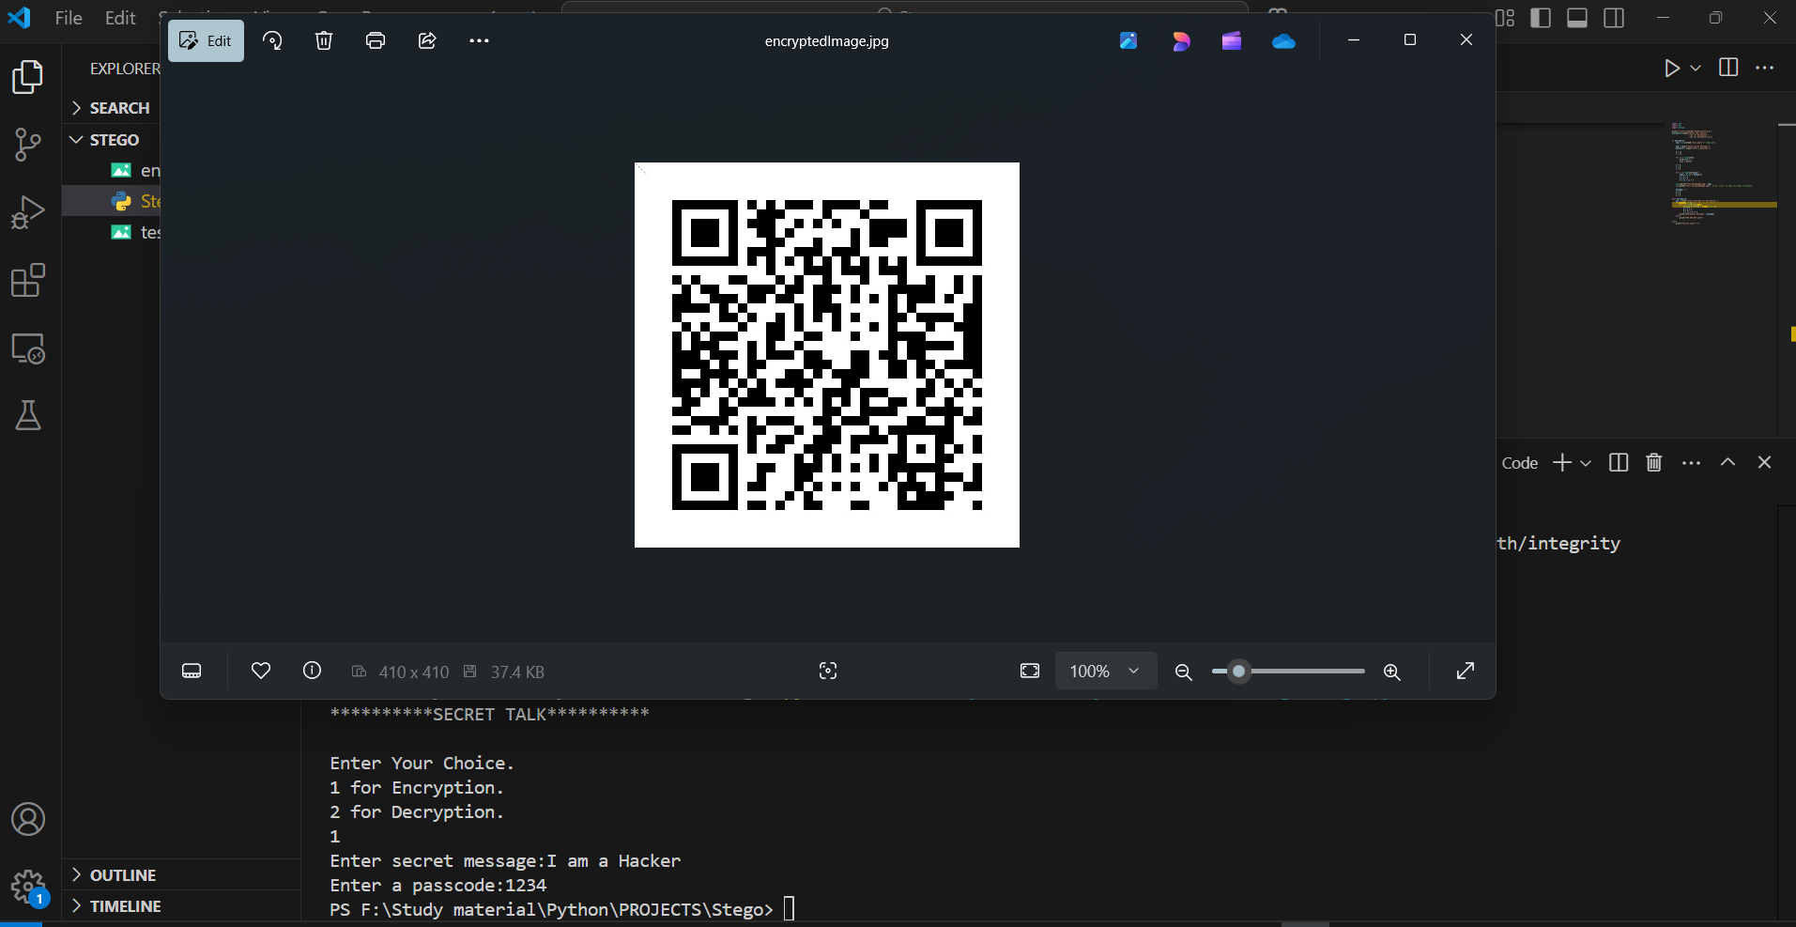
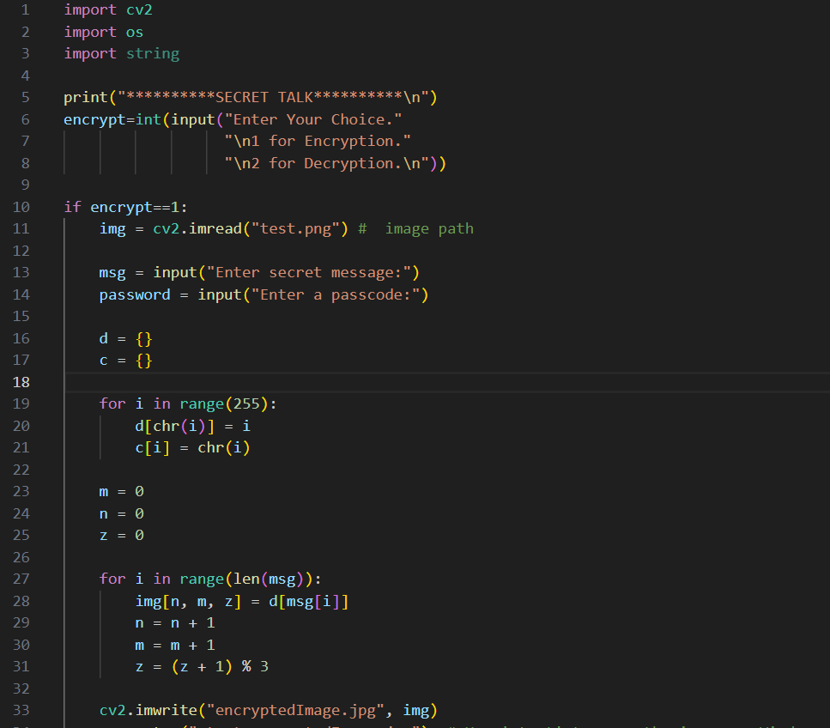
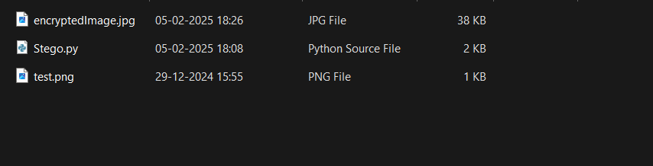
Results

Slide 8
Conclusion
This Python-based steganography project effectively hides messages in images, ensuring secure communication while maintaining image quality. It offers a simple command-line tool that runs on various platforms, making it a valuable resource for privacy-conscious users and security professionals.

Slide 9
GitHub Link
https://github.com/EhshanRaza/Secret-Talk.git

Slide 10
Future scope(optional)
Better Algorithms: Improve for more security and image quality.
More Formats: Include more types of images, audio, and videos.
User-Friendly: Develop a graphical interface.
Mobile App: Create a version for smartphones.
Instant Messaging: Add real-time encrypted messaging.
AI Integration: Use AI to detect and prevent unauthorized access.

Slide 11
THANK YOU

